Slide 1
On one side of the card put your name (first & last). On the other side answer the following:
Welcome
3rd
Answer the following questions on the notecard you picked up on your way in.
1. What’s 1 fun thing you did over winter break?
2. Besides graduating, what’s 1 goal you have for this semester (doesn’t have to be related to this class)?
3. What are your plans after graduation (i.e. college, work, gap year etc./where)?
4. If you won the lottery, what’s one charitable cause you would fix/donate a ton of money to?
5. If you “go live in a fictional world” which movie (or book) would you live in?
6. If you “go live in a fictional world” which movie (or book) would you live in?
When you’re finished, add yourself to Google Classroom & Remind for text reminders:
Google Classroom Code: 3rd qzq0vb
Remind: Text @dfd64b to 81010

Slide 2
On one side of the card put your name (first & last). On the other side answer the following:
Welcome
4th
Answer the following questions on the notecard you picked up on your way in.
1. What’s 1 fun thing you did over winter break?
2. Besides graduating, what’s 1 goal you have for this semester (doesn’t have to be related to this class)?
3. What are your plans after graduation (i.e. college, work, gap year etc./where)?
4. If you won the lottery, what’s one charitable cause you would fix/donate a ton of money to?
5. If you “go live in a fictional world” which movie (or book) would you live in?
When you’re finished, add yourself to Google Classroom & Remind for text reminders:
Google Classroom Code: 4th egjpjlt
Remind: Text @dfd64b to 81010

Slide 3
On one side of the card put your name (first & last). On the other side answer the following:
Welcome
6th
Answer the following questions on the notecard you picked up on your way in.
1. What’s 1 fun thing you did over winter break?
2. Besides graduating, what’s 1 goal you have for this semester (doesn’t have to be related to this class)?
3. What are your plans after graduation (i.e. college, work, gap year etc./where)?
4. If you won the lottery, what’s one charitable cause you would fix/donate a ton of money to?
5. If you “go live in a fictional world” which movie (or book) would you live in?
6. If you “go live in a fictional world” which movie (or book) would you live in?
When you’re finished, add yourself to Google Classroom & Remind for text reminders:
Google Classroom Code: 6th 59l46t
Remind: Text @dfd64b to 81010

Slide 4
On one side of the card put your name (first & last). On the other side answer the following:
Welcome
7th
Answer the following questions on the notecard you picked up on your way in.
1. What’s 1 fun thing you did over winter break?
2. Besides graduating, what’s 1 goal you have for this semester (doesn’t have to be related to this class)?
3. What are your plans after graduation (i.e. college, work, gap year etc./where)?
4. If you won the lottery, what’s one charitable cause you would fix/donate a ton of money to?
5. If you “go live in a fictional world” which movie (or book) would you live in?
6. If you “go live in a fictional world” which movie (or book) would you live in?
When you’re finished, add yourself to Google Classroom & Remind for text reminders:
Google Classroom Code: 7th bei2y0v
Remind: Text @dfd64b to 81010

Slide 5
On one side of the card put your name (first & last). On the other side answer the following:
Welcome
8th
Answer the following questions on the notecard you picked up on your way in.
1. What’s 1 fun thing you did over winter break?
2. Besides graduating, what’s 1 goal you have for this semester (doesn’t have to be related to this class)?
3. What are your plans after graduation (i.e. college, work, gap year etc./where)?
4. If you won the lottery, what’s one charitable cause you would fix/donate a ton of money to?
5. If you “go live in a fictional world” which movie (or book) would you live in?
6. If you “go live in a fictional world” which movie (or book) would you live in?
When you’re finished, add yourself to Google Classroom & Remind for text reminders:
Google Classroom Code: 8th g2id9m7
Remind: Text @dfd64b to 81010

Slide 6
Get into groups of 3-4
Introduce yourself to each other.
Share one of the answers you wrote on your notecard.

Slide 7
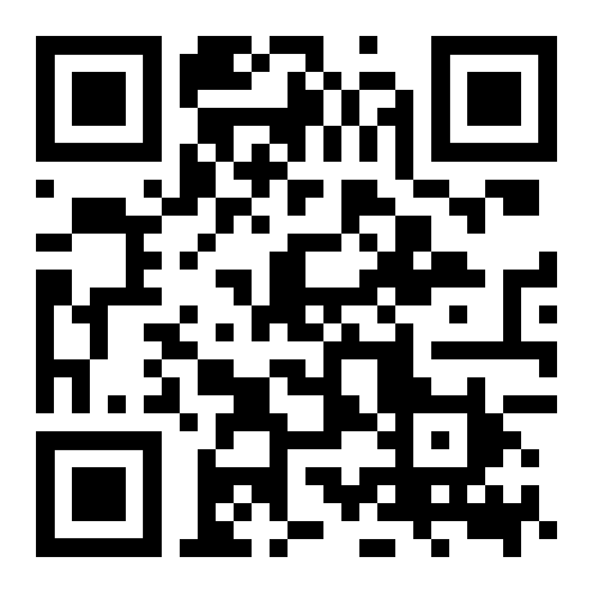
ms. Harmon’s Basic Info
Email: nharmon@eanesisd.net
Schedule:
AM 1st: Conference PM 5th: Lunch (RM 235)
2nd: PLC (Planning) 6th: Econ/Room 235
3rd: Econ/Room 348 7th: Econ/Room 235
4th: Econ/Room 348 8th: Econ/Room 235
Website: whsnharmon.weebly.com
Test Reviews will be in
Room 235

Slide 8
Senioritis
Be on time & come prepared: this includes having a notebook or section specific for Economics, pen/pencil, paper, and iPad.
Ask questions! Be curious. Own your learning.
Be respectful to each other. This includes actions, body language, and the speech we use towards each other.
Food and drink: keep it neat & don’t let it be a distraction. If you see something on the floor, pick it up even if it's not yours.
Bathroom & Water breaks-
When do you think it’s appropriate to do these things?
Cellphones- should be silenced & put away. You should not be using your phone during lecture or activities. (same goes for iPad/other electronic devices)

Slide 9
Scavenger Hunt: Using my website and the syllabus answer the questions on the worksheet

Slide 10
Recap important info
Required assignments will be accepted late, however 20% will be deducted.
Optional assignments will not be accepted late.
Quizzes: can use 1 page chapter notes (I will provide the worksheet, but must be hand written).
Test: may use 1 page of hand written notes.
If you are absent on the day of a quiz or test you will take it the day your return.
If you are absent for a prolonged period you have the # of days you were gone plus one day to make up your work.

Slide 11
Did I miss anything when I was absent?
YES, of course you did!
When you are absent it is YOUR responsibility to find out what you missed and turn in your missing work. I shouldn’t have to track this down!
Prior to your return you should check:
The class website
Google Classroom
Google Calendar/Class Calendar
You should be aware of what you missed prior to coming to me for any work.

Slide 12
Questions?

Slide 13
What is Economics?

Slide 14
Needs VS Wants

Slide 15
What is Economics?
It is the study of how people seek to satisfy their needs and wants by making choices.
It is the science of scarcity

Slide 16
Mr. Clifford Econ Movie Video #1

Slide 17
Homework: Read the syllabus & get acknowledgement form signed

