Slide 1
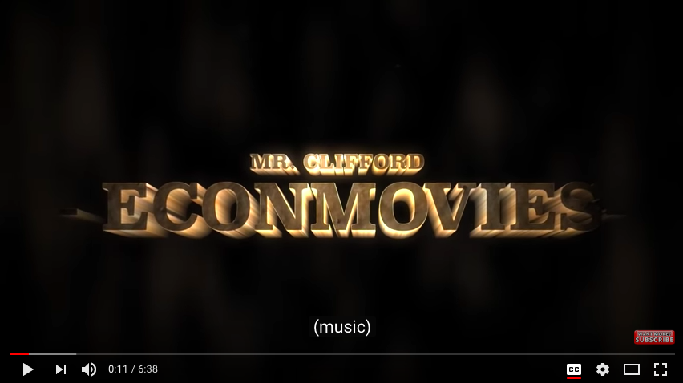
Mr. Clifford: Scarcity and Markets- EconMovies #1: Star Wars
https://www.youtube.com/watch?v=Np-dZSdzymk

Slide 2
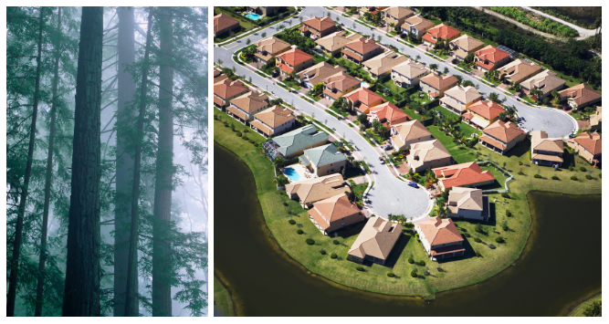
Warm-up #1
Put the # of the warm up & the date on your worksheet
Answer the following questions on your worksheet
Which of the photos represents a limited resource?
Which of the photos represents unlimited wants?
Economics is the study of ___________________.
When you’re done, be sure to turn in your Syllabus Acknowledgement form to Ms. Harmon and get out your notecard from yesterday.

Slide 3
Welcome Back
1. Find someone who you didn’t talk with yesterday
2. Introduce yourselves & then talk about one of the items you wrote about on your card. Pick one you didn’t talk about yesterday.
1. What’s 1 fun thing you did over winter break?
2. Besides graduating, what’s 1 goal you have for this semester (doesn’t have to be related to this class)?
3. What are your plans after graduation (i.e. college, work, gap year etc./where)?
4. If you won the lottery, what’s one charitable cause you would fix/donate a ton of money to?
5. If you “go live in a fictional world” which movie (or book) would you live in?

Slide 4
Warm-up #1
Which of the photos represents a limited resource?
-Redwood Forest
Which of the photos represents unlimited wants?
-Housing development
3. Economics is the study of Scarcity.

Slide 5
Ch. 1
Go to my website> Economics> Unit 1> Chapter 1 Reading
Use the reading to help you answer the question for the worksheet “Chapter One Reading Guide” you picked up on the way in.
You may work in small groups or 3-4
We’ll spend about half the class working on this and then discuss.
***Reminder: This worksheet is what you may use on your quiz.
It is also worth 25 points- due Friday 1/11

Slide 6
Warm-up #2
What do you consider when making daily choices?
How do you make financial/spending decisions? (consider; do you create a budget, spend compulsively, careful with your money, financial goals, etc.)
Answer this question on your Notecard. Using the scale below, how confident do you feel that you’re going to do well in this class? Put your answer next to your name.
1
2
3
4
5
Very worried about how I’m going to pass this class.
Kind of worried, seems hard, feeling stressed.
Feeling okay, seems do able with a lot of studying
Feeling pretty good. With some studying I should be fine.
Totally confident. I’m going to ace this class

Slide 7
Warm-up #2
-Pass up your notecards.
-Discuss with the people around you, your answers to question 1 & 2.
What do you consider when making daily choices?
How do you make financial/spending decisions? (consider; do you create a budget, spend compulsively, careful with your money, financial goals, etc.)

Slide 8
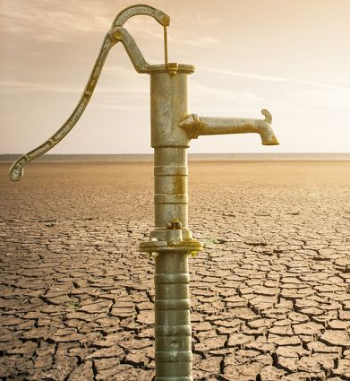
Chapter 1: What is Economics?
1.1 Scarcity & the Science of Economics
1.2 Our Economic Choices
1.3 Using Economic Models
Chapter Essential Question:
In what ways do people cope with the problem of scarcity?

Slide 9
Group Activity
A storm has damaged the main highway leading to your town, so there have been no deliveries of essential, or even nonessential, items to neighborhood stores. Some people are running out of certain things they need or want. Others have lost electric power, and some have no running water. Below is a list of things you have that some of your neighbors are looking for. For each item, explain a least one way you think is best (and perhaps fairest) to distribute these items among your neighbors.
One loaf of bread
One bicycle
An assortment of handyman tools in one toolbox
One bottle of aspirin
One half-full bottle of antiseptic and 10 cotton balls
Two one-gallon jugs of bottled water
One smart phone
Three blankets
Ten towels
One MP3 player
On a piece of notebook paper work with your group determine the possible person to receive the item.
For example, would a neighbor with three children merit the loaf of bread? Or an elderly woman receive a blanket?

Slide 10
Scarcity and the Science of Economics
1
What is Economics?
How do economists define scarcity?
What are the factors of production?

Slide 11
What is Economics?
1
It’s the study of how people make choices to satisfy their wants.
For example:
You must choose how to spend your time
Businesses must choose how many people to hire

Slide 12
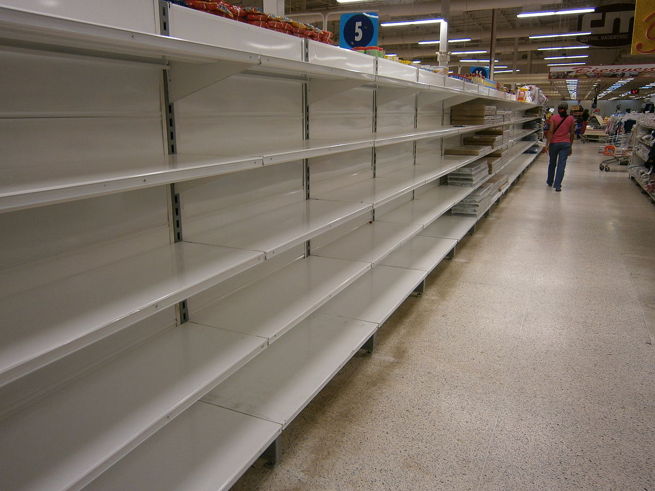
Scarcity & Shortages
1
Scarcity occurs when there are limited quantities of resources to meet unlimited needs or wants.
Shortages occur when producers will not or cannot offer goods or services at current prices

Slide 13
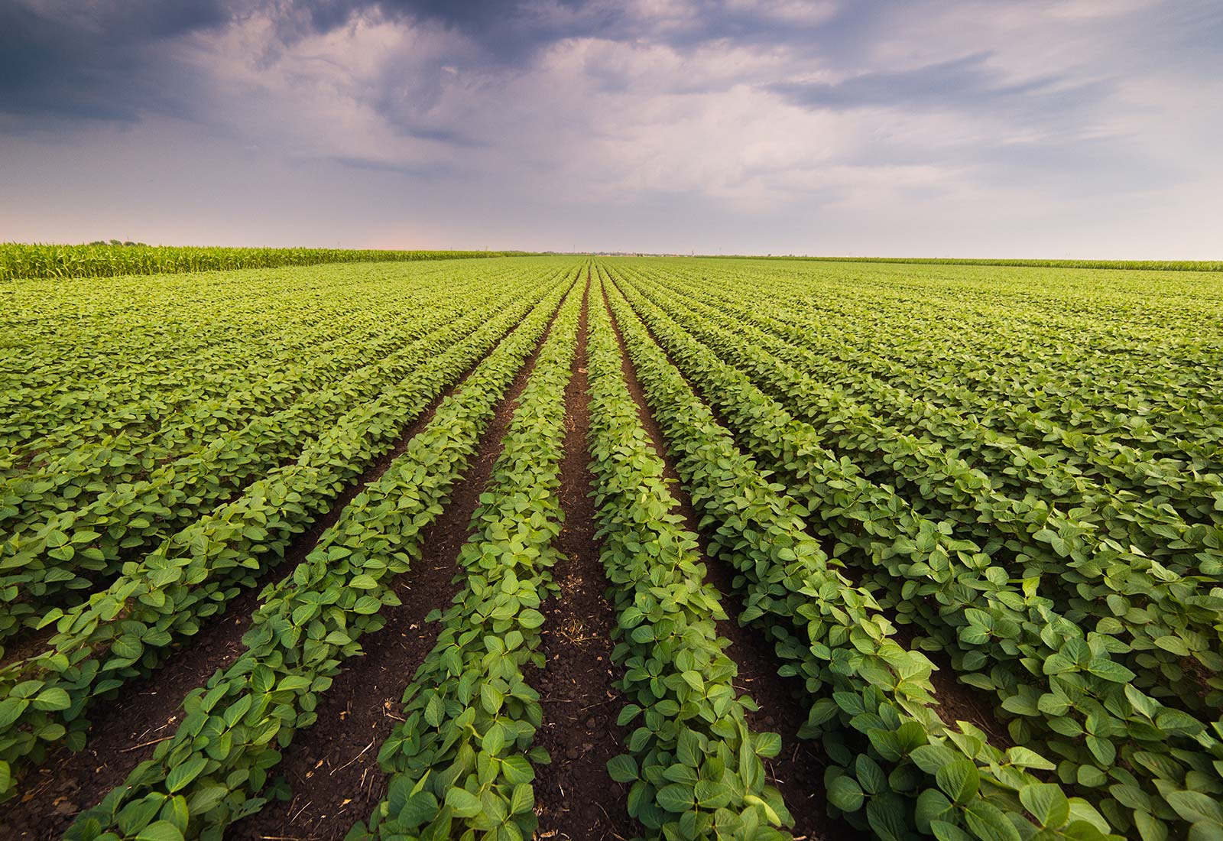
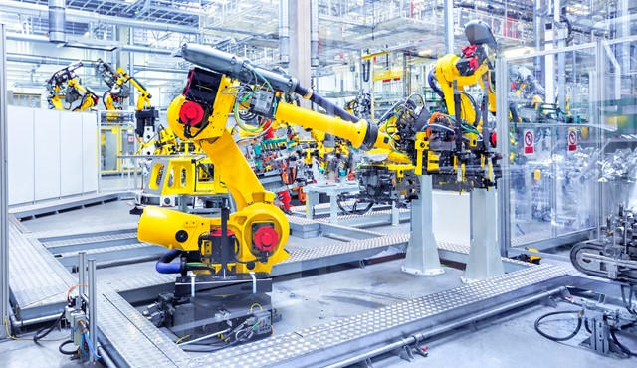
The Factors of Production
1
Land
All natural resources used to produce goods and services.
Labor
Any effort a person devotes to a task for which that person is paid.
Capital
Any human-made resource used to create other goods and services.
Entrepreneurs
Risk-taking individuals who introduce new products or services in search of profits; decides how to use the other 3 factors of production.
Notes:
Land is short for all the natural resources available to create supply. It includes raw property and anything that comes from the ground. It can be a non-renewable resource.
That includes commodities such as oil and gold. It can also be a renewable resource, such as timber. Once man changes it from its original condition, it becomes a capital good. For example, oil is a natural resource, but gasoline is a capital good. Farmland is a natural resource, but a shopping center is a capital good.

Slide 14
Assessment
1
1. What is the difference between a shortage and scarcity?
(a) A shortage can be temporary or long-term, but scarcity always exists.
(b) A shortage results from rising prices; a scarcity results from falling prices.
(c) A shortage is a lack of all goods and services; a scarcity concerns a single item.
(d) There is no real difference between a shortage and a scarcity.
2. Which of the following is an example of using physical capital to save time and money?
(a) hiring more workers to do a job
(b) building extra space in a factory to simplify production
(c) switching from oil to coal to make production cheaper
(d) lowering workers’ wages to increase profits

Slide 15
Assessment: Answers
1
1. What is the difference between a shortage and scarcity?
(a) A shortage can be temporary or long-term, but scarcity always exists.
(b) A shortage results from rising prices; a scarcity results from falling prices.
(c) A shortage is a lack of all goods and services; a scarcity concerns a single item.
(d) There is no real difference between a shortage and a scarcity.
2. Which of the following is an example of using physical capital to save time and money?
(a) hiring more workers to do a job
(b) building extra space in a factory to simplify production
(c) switching from oil to coal to make production cheaper
(d) lowering workers’ wages to increase profits

Slide 16
Warm-up #2
What do you consider when making daily choices?
How do you make financial/spending decisions? (consider; do you create a budget, spend compulsively, careful with your money, financial goals, etc.)
Scan QR code to get to the website and take the quiz. Some questions may not apply to you right now, just answer based on what you think you would do. Write down your result on your worksheet.

Slide 17
Warm-up #2
Discussion:
What do you consider when making daily choices?
How do you make financial/spending decisions? (consider; do you create a budget, spend compulsively, careful with your money, financial goals, etc.)
What result did you get from the quiz?
“A good financial plan is a road map that shows us exactly how the choices we make today will affect our future”- Alexa Von Tobel

Slide 18
Our Economic Choices
2
Does every decision you make involve trade-offs?
How can a decision-making grid help you identify the opportunity cost of a decision?
How will thinking at the margin affect decisions you make?

Slide 19
Trade-offs & Opportunity Costs
2
Trade-offs are all the alternatives that we give up whenever we choose one course of action over others.
The most desirable alternative given up as a result of a decision is known as opportunity cost.
All individuals and groups of people make decisions that involve trade-offs.

Slide 20
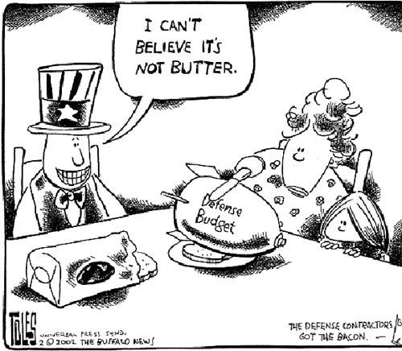
Trade-offs & Opportunity Costs
2
Guns or butter: refers to the trade-offs that nations face when choosing whether to produce more or less military or consumer goods.
Example: Soviet spending during the Cold War.

Slide 21
The Decision Making Grid
2
Economists encourage us to consider the benefits and costs of our decisions.
Karen’s Decision-making Grid
Alternatives
Sleep late
Wake up early to study
Benefits
Decision
Opportunity cost
Benefits forgone

Slide 22
The Decision Making Grid
2
Economists encourage us to consider the benefits and costs of our decisions.
Karen’s Decision-making Grid
Alternatives
Sleep late
Wake up early to study
Benefits
Enjoy more sleep
Have more energy during the day
Better grade on test
Teacher and parental approval
Personal satisfaction
Decision
Sleep late
Wake up early to study for test
Opportunity cost
Extra study time
Extra sleep time
Benefits forgone
Better grade on test
Teacher and parental approval
Personal satisfaction
Enjoy more sleep
Have more energy during the day

Slide 23
Thinking at the Margin
2
When you decide how much more or less to do, you are thinking at the margin.
Options
1st hour of extra study time
2nd hour of extra study time
3rd hour of extra study time
Benefit
Grade of C on test
Grade of B on test
Grade of B+ on test
Opportunity Cost
1 hour of sleep
2 hours of sleep
3 hours of sleep

Slide 24
Assessment
2
1. Opportunity cost is
(a) any alternative we sacrifice when we make a decision.
(b) all of the alternatives we sacrifice when we make a decision.
(c) the most desirable alternative given up as a result of a decision.
(d) the least desirable alternative given up as a result of a decision.
2. Economists use the phrase “guns or butter” to describe the fact that
(a) a person can spend extra money either on sports equipment or food.
(b) a person must decide whether to manufacture guns or butter.
(c) a nation must decide whether to produce more or less military or consumer goods.
(d) a government can buy unlimited military and civilian goods if it is rich enough.

Slide 25
Assessment: Answers
2
1. Opportunity cost is
(a) any alternative we sacrifice when we make a decision.
(b) all of the alternatives we sacrifice when we make a decision.
(c) the most desirable alternative given up as a result of a decision.
(d) the least desirable alternative given up as a result of a decision.
2. Economists use the phrase “guns or butter” to describe the fact that
(a) a person can spend extra money either on sports equipment or food.
(b) a person must decide whether to manufacture guns or butter.
(c) a nation must decide whether to produce more or less military or consumer goods.
(d) a government can buy unlimited military and civilian goods if it is rich enough.

Slide 26
Mr. Clifford- Marginal Analysis
2

Slide 27
Warm-up #3

Slide 28
Using Economic Models
3
What is a production possibilities graph?
How do production possibilities graphs show efficiency, growth, and cost?

Slide 29
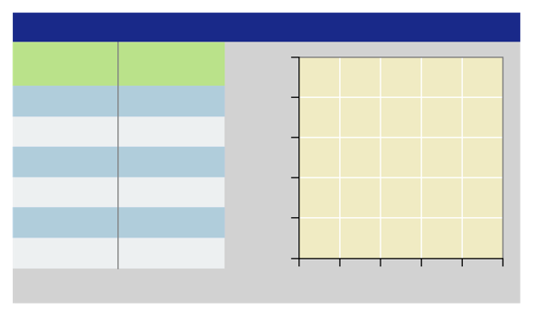
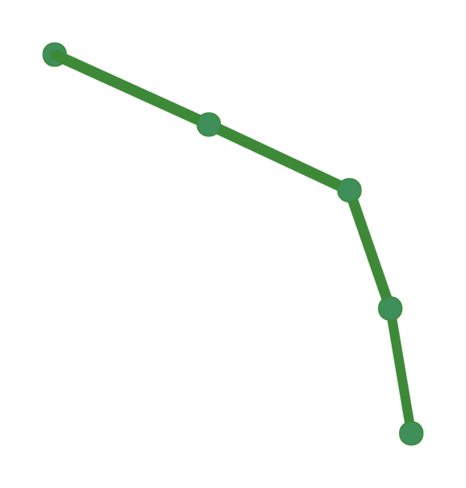
Production Possibilities
3
A production possibilities graph shows alternative ways that an economy can use its resources.
The production possibilities frontier is the line that shows the maximum possible output for that economy.
Production Possibilities Graph
25
20
15
10
5
Watermelons (millions of tons)
Shoes (millions of pairs)
0
15
8
14
a (0,15)
b (8,14)
14
18
20
21
12
9
5
0
Shoes (millions of pairs)
c (14,12)
d (18,9)
A production
possibilities frontier
e (20,5)
f (21,0)
0
5
10
15
20
25
Watermelons (millions of tons)

Slide 30
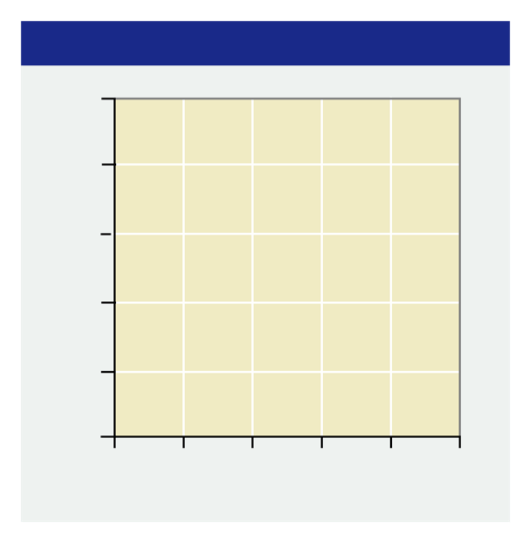
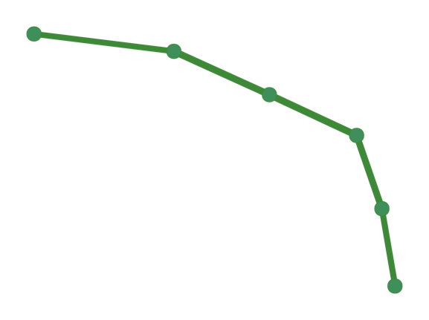
Efficiency
3
Production Possibilities Graph
Efficiency means using resources in such a way as to maximize the production of goods and services.
An economy producing output levels on the production possibilities frontier is operating efficiently.
Underutilization: using fewer resources than an economy is capable of using. (g)
25
20
15
10
5
S
a (0,15)
Shoes (millions of pairs)
b (8,14)
c (14,12)
g (5,8)
d (18,9)
e (20,5)
A point of underutilization
f (21,0)
0
5
10
15
20
25
Watermelons (millions of tons)

Slide 31
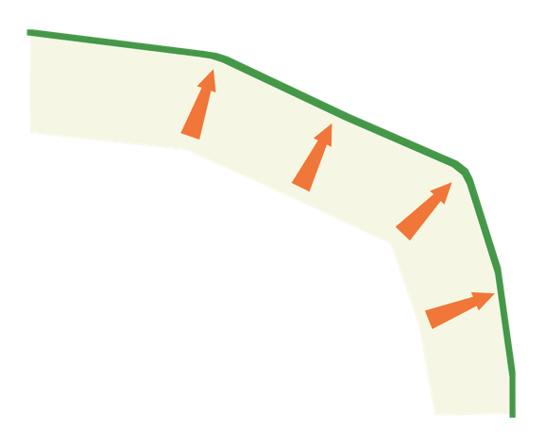
Growth
3
Growth: If more resources become available, or if technology improves, an economy can increase its level of output and grow.
When this happens, the entire production possibilities curve “shifts to the right.”
Production Possibilities Graph
25
20
15
10
5
Future production
Possibilities frontier
T
S
a (0,15)
Shoes (millions of pairs)
b (8,14)
c (14,12)
d (18,9)
e (20,5)
f (21,0)
0
5
10
15
20
25
Watermelons (millions of tons)

Slide 32
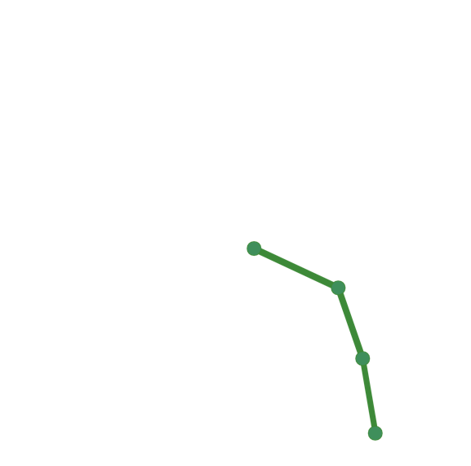
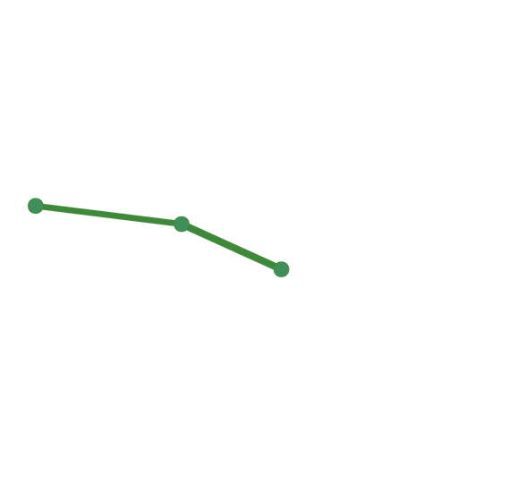
Cost
3
Cost: A production possibilities graph shows the cost of producing more of one item.
To move from point c to point d on this graph has a cost of 3 million pairs of shoes.
Production Possibilities Graph
25
20
15
10
5
Watermelons (millions of tons)
Shoes (millions of pairs)
0
15
8
14
14
18
20
21
12
9
5
0
Shoes (millions of pairs)
c (14,12)
d (18,9)
0
5
10
15
20
25
Watermelons (millions of tons)

Slide 33
Assessment
3
1. A production possibilities frontier shows
(a) farm goods and factory goods produced by an economy.
(b) the maximum possible output of an economy.
(c) the minimum possible output of an economy.
(d) underutilization of resources.
2. An economy that is using its resources to produce the maximum number of goods and services is described as
(a) efficient.
(b) underutilized.
(c) growing.
(d) trading off.

Slide 34
Assessment
3
1. A production possibilities frontier shows
(a) farm goods and factory goods produced by an economy.
(b) the maximum possible output of an economy.
(c) the minimum possible output of an economy.
(d) underutilization of resources.
2. An economy that is using its resources to produce the maximum number of goods and services is described as
(a) efficient
(b) underutilized
(c) growing
(d) trading off

Slide 35
Mr. Clifford: Monster’s Inc. Video
3

