Slide 1
Project Overview
Project Name | Company Name | Presenter Name

Slide 2
Happy Friday! You’ve made it through the 1st week
Today’s Agenda
Instructions
Take Chapter 1 Quiz
Begin Chapter 2 Question Guide- Vocabulary
National Economic Policy Goals
You will need something to write with and your Chapter 1 Worksheet.
Clear everything else off your desk.
After you complete the Quiz, turn it in with your Chapter 1 Question Guide.
Pick up Chapter 2 Question Guide and the National Economic Policy Goal worksheet.
Begin working on the vocabulary for Chapter 2. The reading for Chapter 2 is on my website.
Once everyone is done with the quiz we’ll start looking at economic questions & goals.

Slide 3
Economic Systems
Scarcity!
Nations have to answer some hard economic questions.
Because of these questions, nations evolve in order to respond to the problem of scarcity.
Economic systems are used by society’s to produce and distribute goods.
Figuring out what the right system is depends one the society’s goals and values.

Slide 4
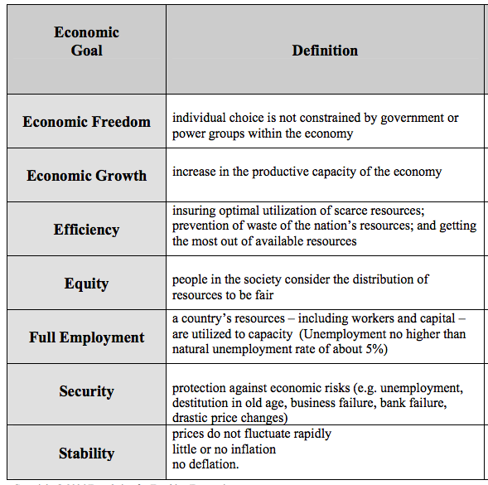
Each society answers the 3 basic questions differently
Based on the importance of each of the economic goals.
Think about your own priorities.
On your worksheet, rank the goals in order 1 (highest) to 7 (lowest) based on your own priorities.

Slide 5
Each society answers the 3 basic questions differently
Get into groups of 4-6.
You need to work together to come to a group consensus in your rankings.
Mark this in the right column of your worksheet.

Slide 6
Each society answers the 3 basic questions differently
Second gird handout.
Write ”Minimum Wage Policies” at the top of the first of the 3 policy columns.
Work together to mark + or – in each goal column.
+ the legislation promotes the goal
– the legislation undermines the goal
Mark this in the right column of your worksheet.

Slide 7
Each society answers the 3 basic questions differently
Now look back at the ranking of goals that your group determined were priorities.
Are “Minimum Wage Policies” compatible with the goals that you’ve identified as being important?

Slide 8
Debrief
Why can’t we accomplish all our economic goals?
How do personal values, and perceptions of costs and benefits affect the way people prioritize national economic goals?
What might a lack of consensus on economic goals impact the creation of economic policy?
Why is understanding marginal analysis important in efforts to achieve national goals?

