Slide 1

Balanced scorecard slide 1
Chapter 11:
Financial Markets
Unit 4

Slide 2

Welcome: Pick up the Study Guide & Warm-up sheet on your way in
Tues. 4/2/19
L1
Answer the following questions on your Warm-up sheet (#1):
  What’s the surest method of accumulating $1 million- saving or gambling?
  Whenever you have extra money (as a gift, from your paycheck, etc.) what do you do with it?
  Go to https://www.bankrate.com/calculators/savings/save-million-calculator.aspx to figure out how much you have to save each month to reach a million by retirement age.
    Consider when you want to retire (avg. 65) & how much you think you can save once you’ve started your career.
    How much do you need to invest each month to reach $1 million, at what interest rate and at what retirement age?
You can find the link to the website on Google Classroom>classroom>Unit 4>Link to calculate savings
When you’re done with the warm-up, start working on the vocabulary for 11.1: Savings & Financial Systems.- Reading is on my website

Slide 3
Today’s Agenda
L1
We’re starting the chapter by looking Savings and the role it plays in the financial system.
Watch the Difference between Saving & Investing
  https://www.youtube.com/watch?v=LsDKT7P_iws&feature=youtu.be
Watch How much should I save?
  https://www.youtube.com/watch?v=u-gFLH3Epb0&feature=youtu.be
Lecture on key aspects of Circular Flow of Finance, Capital Formation, Financial Intermediaries and Investment Considerations.

Slide 4
Difference b/t Saving & Investing
Watch the Difference between Saving & Investing
  https://www.youtube.com/watch?v=LsDKT7P_iws&feature=youtu.be
Determine whether each action is an example of saving or investing:
  Putting $20 per paycheck into an account to help pay for books during college
  Contributing 3% of your paycheck to a 401(k) plan offered through your job
  Buying shares of stock in your favorite clothing company
  Giving your cousin $5000 to help start his business, in exchange for 5% of his monthly profits
  Depositing your annual income tax return into an account until you have enough to buy a car

Slide 5
How much should I save?
Watch How much should I save?
  https://www.youtube.com/watch?v=u-gFLH3Epb0&feature=youtu.be
How much does Kal Penn recommend you save?
Why does it make sense to start saving or investing right now?

Slide 6
Savings: WHAT IS IT & WHY IS IT IMPORTANT
L1
Savings makes economic growth possible- it makes funds available for others to use.
Methods of Saving
Financial Assets
Opening a savings account
Buying bonds
Purchasing Certificate of Deposit (CD)
All documents that represent a claim on the income & property of the borrower.
Includes: stocks, savings, CDs, Treasury bills, and mortgages.
You put money in a savings account, you get a receipt for your deposit. If you put your money it a CD- which is like a loan to the bank→ you get a different receipt. Both signify your claim on the property

Slide 7
Financial System
This is a network of savers, investors, and financial institutions that work together to transfer savings to investment use.

Slide 8
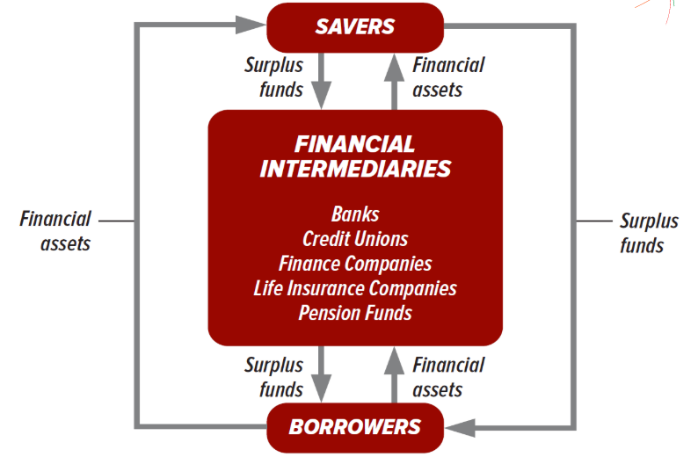
The Circular Flow OF FINANCE
L1
THIS IS A VISUAL REPRESENTATION OF THE FINANCIAL SYSTEM
It’s made up of the following parts:
Savings: consists of savers who provide the money that borrowers will use.
Financial Intermediaries: Institutions that channel savings to investors; banks, insurance co. savings & loan associations & credit unions.
Borrowers: They use the funds for various purposes (business owners & individuals)
Financial Assets: Bonds, CDs, & other documents that show that borrowing has taken place & there is a claim on the income and assets of the borrower.

Slide 9
Financing Capital Formation
L1
Depends on saving and borrowing.
  Households: invest in homes
  Business: invest in tools, equipment, & machinery.
  Government: invest in highways, hospitals, universities & other public goods.
Everyone benefits from an efficient financial system.
This smooth flow of funds through the system helps ensure that savers have an outlet for their savings and then borrowers have a source of financial capital that can be invested.

Slide 10
Happy Wednesday: Warm-Up #2
Wed. 4/3/19
What are your financial goals? Short term or Long Term.
What types of savings or investing accounts do you think will help you reach those goals?
What’s the safest way to hang on to your money?
How much risk do you think you can handle when it comes to your money? High, low, moderate? Why?
You’ll need your Study Guide out.
Be sure to pick up the worksheet on your way in. We’ll work on this later in class.

Slide 11
Financial Intermediaries
L1
BANKS
  Fewer than 6000 banks in our country, but have multiple branches all over.
  Offer checking accounts, savings accounts, & CDs to attract deposits from consumers.
  Most profitable customers are usually commercial businesses.
  Also, might offer credit cards→fees for overdrafts and late credit card payments are a major source of profit.
CREDIT UNIONS
  Nonprofit cooperatives→ accept deposits, make loans, issue CDs & offer checking
  Owned & operated by members.
  7200 small credit unions throughout the country.
  Most are connected with a single employer.
  Only provide services to members

Slide 12
Financial Intermediaries
L1
FINANCE COMPANIES
  Specialize in making loans directly to consumers
  Buy installment contracts from merchants who sell goods on credit.
  Carry loans to the full term or take consumers to court if they don’t pay
  Tend to make some high risk loans→ can then charge more
LIFE INSURANCE COMPANIES
  Primary purpose is to provide financial protection in case of death.
  Use surplus premiums to offer loans to businesses or individuals.
PENSION FUNDS
  Retirement fund based on contributions from employer
  Provides funds when employee is of retirement age.
  During the 30-40 years that the money is collected it can be used to invest in high-quality stocks and bonds.

Slide 13

All
FINANCIAL Intermediaries
L1
Accept deposits or contributions from individuals, businesses, and/or governments.
The accumulated funds are then loaned out to borrowers.
Savings in a strong financial system can be made available for use by others in the economy.

Slide 14

Basic INVESTMENT Considerations
L1
Before you decide to participate in the financial system you need to be aware of the 4 basic considerations.
  Consistency
  Simplicity
  The Risk-Return Relationship
  Investment Objectives

Slide 15
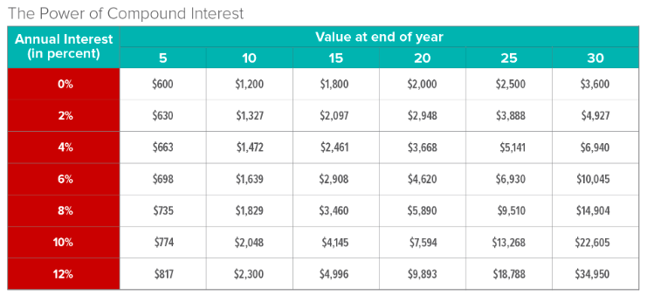
1. CONSITENCY
L1
Most successful investors invest consistently over long periods.
Investing on a regular basis is just as important as the amount invested.

Slide 16
2. SIMPLICITY
L1
According to successful investors, you should IGNORE any investment that seems:
  Too complicated, or you don’t understand.
  Too good to be true, because it probably is
Some investors get lucky, but most build wealth because they invest regularly & avoid out of the ordinary investments
Stay with what you understand!

Slide 17
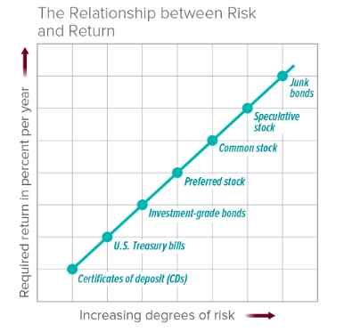
3. The Risk-Return RELATIONSHIP
L1
RISK is the degree to which the outcome is uncertain but a probably outcome can be estimated.
Investors realize some investments are riskier then others, so they demand higher compensation $$$.
As an investor you have to consider the level of risk you can tolerate.

Slide 18
4. Investment OBJECTIVE
L1
WHAT’S YOUR REASON FOR INVESTING?
  If you want to cover your living expenses during random periods of unemployment, you might want financial assets that can be easily converted into cash.
  If you want to save for retirement, another type of financial asset might work better, such as a 401(k).
If you were to invest your money, what would your objectives be?

Slide 19
Activity- RISK
L1
Things to remember when saving/investing:
  Invest only what you can afford to lose.
  Invest at your comfort level.
  Invest according to your age

Slide 20
Investment SITUATIONS
L1
1. You received $1,000 in gift money for your high school graduation. You have no need for this money anytime soon.
2. You have $18,000 that you'll need for college next year.
3. You inherited $10,000 from your great aunt that you would like to use as a down payment on a house you plan to buy next year.

Slide 21
Handout #2
L1
Rank the scenarios 1-10
  Lowest risk/lowest reward= 1
  Highest risk/lowest reward=10

Slide 22
Which type of asset is riskier?

Slide 23

savings account
vs.
U.S. government bond

Slide 24
checking account
vs.
certificate of deposit

Slide 25
certificate of deposit
vs.
U.S. government bond

Slide 26
U.S. government bond
vs.
municipal bond

Slide 27
municipal bond
vs.
special purpose bond

Slide 28
special purpose bond
vs.
corporate bond

Slide 29
corporate bond
vs.
growth mutual fund

Slide 30
growth mutual fund
vs.
blue chip stock

Slide 31
blue chip stock
vs.
real estate

Slide 32
real estate
vs.
gold and silver

Slide 33
art collection
vs.
income mutual fund

Slide 34
stuffed animal collection
vs.
gold and silver

Slide 35
gold and silver
vs.
savings account

Slide 36
income mutual fund
vs.
growth mutual fund

Slide 37
penny stock
vs.
blue chip stock

Slide 38
Handout #7
L1
Place the financial investments in the right order (draw a line to the correct spot)
Highest Risk on the top
Lowest Risk on the bottom

Slide 39
Answers: Handout #7
L1
High Risk
Gold
Art Collection
Commercial Property
Apple Stock
Income Mutual Funds
Corporate Bonds
Government Securities
Certificate of Deposit
Savings Account
Checking Account
Low Risk

Slide 40
Answers: Handout #7
L1
High Risk
20._______
21._______
22._______
24._______
25._______
26._______
23._______
Low Risk

Slide 41
Bonds as Financial Assets
Bonds are basically loans, or IOUs, that represent debt that the government or a corporation must repay to an investor. Bonds have three basic components:
  1. The coupon rate — the interest rate that the issuer will pay the bondholder.
  2. The maturity — the time when payment to the bondholder is due.
  3. The par value — the amount that an investor pays to purchase the bond and that will be repaid to the investor at maturity.
Not all bonds are held to maturity. Sometimes bonds are traded or sold and their price may change. Economists therefore refer to a bond’s yield, which is the annual rate of return on the bond if the bond were held to maturity.

Slide 42

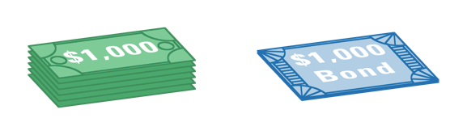
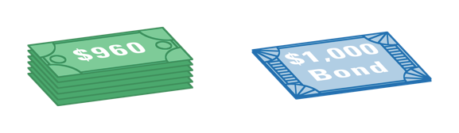
Buying Bonds at a Discount
Investors earn interest on the bonds they buy. They can also earn money by buying bonds at a discount from par.
Discounts from Par
1.
Sharon buys a bond with a par value of $1,000 at 5 percent interest.
=
Bond purchase without discount from par
2.
Interest rates go up to 6 percent.
3.
Sharon needs to sell her bond. Nate wants to buy it, but is unwilling to buy a bond at 5 percent interest when the current rate is 6 percent.
4.
Sharon offers to discount the bond, taking $40 off the price and selling it for $960.
5.
Nate accepts the offer. He now owns a $1,000 bond paying 5 percent interest, which he purchased at a discount from par.
=
Bond purchase with discount from par

Slide 43
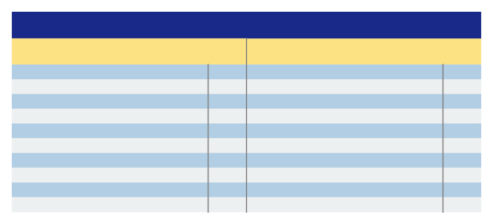
Bond Ratings
Standard & Poor’s and Moody’s rate bonds on a number of factors, including the issuer’s ability to make future payments and to repay the principal when the bond matures.
A high bond rating usually means that the bond will sell at a higher price, and that the firm will be able to issue the bond at a lower interest rate.
Bond Ratings
Standard & Poor’s
Moody’s
Highest investment grade
High grade
Upper medium grade
Medium grade
Lower medium grade
Speculative
Vulnerable to default
Subordinated to other debt rated CCC
Subordinated to CC debt
Bond in default
AAA
AA
A
BBB
BB
B
CCC
CC
C
D
Best quality
High quality
Upper medium grade
Medium grade
Possesses speculative elements
Generally not desirable
Poor, possibly in default
Highly speculative, often in default
Income bonds not paying income
Interest and principal payments in default
Aaa
Aa
A
Baa
Ba
B
Caa
Ca
C
D

Slide 44
Advantages and Disadvantages to Bond Issuers
Bonds are desirable from the issuer’s point of view for two main reasons:
  1. Once the bond is sold, the coupon rate for that bond will not go up or down.
  2. Unlike stock, bonds are not shares of ownership in a company.
Bonds also pose two main disadvantages to the issuer:
  1. The company must make fixed interest payments, even in bad years when it does not make money.
  2. If the issuer does not maintain financial health, its bonds may be downgraded to a lower bond rating. This makes it harder to sell future bonds unless a discount or higher interest rate is offered.

Slide 45

Types of Bonds
Savings Bonds
Savings bonds are low-denomination ($50 to $10,000) bonds issued by the United States government. Savings bonds are purchased below par value (a $100 savings bond costs $50 to buy) and interest is paid only when the bond matures.
Treasury Bonds, Bills, and Notes
These investments are issued by the United States Treasury Department.
Municipal Bonds
Municipal bonds are issued by state or local governments to finance such improvements as highways, state buildings, libraries, and schools.
Corporate Bonds
A corporate bond is a bond that a corporation issues to raise money to expand its business.
Junk Bonds
Junk bonds are lower-rated, potentially higher-paying bonds.

Slide 46
Other Types of Financial Assets
Certificates of Deposit
Certificates of deposit (CDs) are available through banks, which use the funds deposited in CDs for a fixed amount of time.
CDs have various terms of maturity, allowing investors to plan for future financial needs.
Money Market Mutual Funds
Money market mutual funds are special types of mutual funds.
Financial managers pool the deposits of their customers to purchase stocks and bonds.
Investors receive higher interest on a money market mutual fund than they would receive from a savings account or a CD. However, assets in money market mutual funds are not FDIC insured.

Slide 47
Financial Asset Markets
One way to classify financial asset markets is according to the length of time for which the funds are lent.
  Capital markets are markets in which money is lent for periods longer than a year. CDs and corporate bonds are traded in capital markets.
  Money markets are markets in which money is lent for periods of less than a year. Short-term CDs and Treasury bills are traded in money markets.
Markets can also be classified according to whether assets can be resold to other buyers.
  Primary markets involve financial assets that cannot be transferred from the original holder, such as savings bonds.
  Secondary markets involve financial assets that can be resold, such as stocks.

Slide 49


Happy Friday!
Today’s Agenda
Finish up the Lesson on Bonds from yesterday.
Read the article on How to Invest in Stocks and complete the worksheet. –Link on my website or use the QR code.
If you finish early work your study guide
Let’s review and talk about resources for evaluating stocks.
If you need something to do check out the PowerPoint on my website to help you finish up your study guide.

Slide 50
Stockbroker VS. Internet discount broker
Stockbroker:
A person who buys or sells equities for his/her clients.
Offer recommendations & advice as part of the service.
Earn a fee based on the size of the investor’s transaction (purchase or sale)
Internet Discount broker
Investor’s can open an internet account with a discount brokerage firm.
Allows investors to buy, sell, and monitor their stock portfolio.
Charge less for each transaction
Offer overviews & summaries of developments in key industries that appear to have more promise.

Slide 51
Supply, Demand & Share Values
Almost all stocks go up and down daily (sometimes a little or sometimes a lot)
Investor expectations are influential because they affect both the supply and demand for stocks.
If an investor thinks prices will go up, they’ll try to buy shares before other’s
But if everyone tries to buy stocks at the same time, the price will go up because of the increase in demand.

Slide 52
Stock Performance
52 Weeks—The high and low prices for the past 12 months. During that period, a single share of Estée Lauder sold for as much as $42.01 and for as little as $29.98. We are not told when the high and low prices occurred, only that they did.
Stock (SYM)—A unique and easily remembered character string usually selected by the corporation.
DIV—The company’s annual dividend that is paid in four equal installments. The FDX annual dividend is $0.32, so each quarterly check is $0.08 per share.
Yld%—Think of this as being roughly similar to the interest return on a bank deposit. Therefore, if you bought one company’s share at the closing price of $6.91, you would receive a $0.40 annual dividend. The dividend yield is DIV/LAST, or $0.40/$6.91 = 0.0579, or 5.79 percent.
PE—This symbol stands for the ratio of last share price to annual earnings per share. It is used as a measure of valuation and tells us how much an investor is willing to pay to get $1 of current earnings. The PE is also referred to as a “multiple,” because it tells us how much an investor is willing to pay for a dollar of earnings. PEs can also change if the value in either the numerator or the denominator changes. Two years after Ford returned to profitability, for example, its stock price rose to $17.41, and its earnings per share rose to $1.51, giving it a PE ratio of 11.52. (Values not shown in Figure 11.6)
100s—Volume of shares traded that day in hundreds.
LAST—Tells us the final, or closing, price for a share of stock that day.
NET CHG—Tells us how the most recent closing price compared to the previous closing price. FedEx closed at $109.92, which was $5.51 lower than the previous day's closing price.

Slide 53
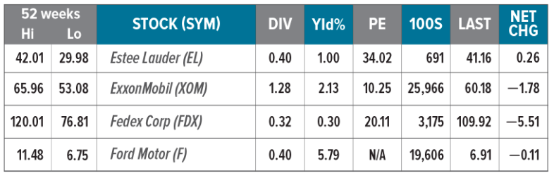
Stock Charts

Slide 54

Stock Prices and Efficient Markets
Investors may buy and sell equities through a stockbroker or by opening an Internet account with a discount brokerage firm.
Changes in the supply and demand for individual stocks affect the value of the stocks on a daily basis.
Understanding stock listings requires that you understand the symbols used, including 52 Weeks, Stock (SYM), DIV, Yld%, PE, 100s, LAST, and NET CHG.
The Efficient Market Hypothesis states that stocks are usually priced correctly, so bargains are hard to find.
Portfolio diversification tends to even out gains and losses.
Mutual funds provide diversification and lower risk by purchasing stocks issued by hundreds or thousands of companies.
401(k) plans are tax-deferred investment and savings plans that act as personal pension funds for employees.

Slide 55
Stock Markets and Their Performance
The two largest stock exchanges are now NYSE Euronext and AMEX-NASDAQ.
Measures of stock performance include the Dow Jones Industrial Average (DJIA) and the Standard & Poor’s 500 (S&P 500).
A bull market is one in which prices move up for several months or years in a row; a bear market is one in which prices fall sharply for several months or years in a row.

Slide 56
Trading in the Future
Most buying and selling takes place in the present (spot market).
A futures contract is an agreement to buy or sell at a specific future date at a predetermined price.
An option is a futures contract that gives the buyer the right to cancel the contract if the price drops.
A call option is the right to buy something at a specific future price, or cancel if the actual future price is not advantageous to the buyer.
A put option is the right to sell something at a specific future price, or cancel if the actual future price is not advantageous to the buyer.

Slide 57
Study Guide Questions 11.3
Why is portfolio diversification important?
Diversification helps reduce the likelihood of significant drops in the investor’s investments.
What happens if you try to take your 401(k) funds out early?
This is retirement income so there is a penalty if you take your money out before age 59 1/2. The penalty is currently 10% of the funds you withdraw, in addition to the ordinary income taxes that you pay when you withdraw the funds.
What determines the value of a stock?
The number of outstanding shares to be traded, a company’s profitability, and expectations for the company’s growth.
How is stock market performance evaluated?
Stock market performance is evaluated by referring to two indicators: the Dow Jones Industrial Average or the Standard & Poor’s 500.
What’s the difference between the Dow Jones Industrial Average and Standard & Poor’s 500?
The DJIA is a measure of the stock performance of a sample of 30 companies. S&P’s 500 monitors the price of 500 stocks.
Describe each of the following stock markets:
  NYSE Euronext: Originally known as New York Stock Exchange (NYSE) until it merged with Euronext in 2007; until recently, the oldest, largest, and most prestigious of the organized stock exchanges in the U.S.
  AMEX-NASDAQ: Originally known as American Stock Exchange (AMEX) until it merged with a major over-the-counter market in 2008; attracted many smaller and lesser-known firms; sells other financial assets such as options and futures.
Why might a contract that takes place in the future be an advantage to the buyer or seller?
The buyer may want to lock in a good price today in case it goes up in the future; the seller may want to lock in a price today in case it goes down in the future.

Slide 58
Welcome Back: Warm-up #3
Mon. 4/8/19
What does the image to the right represent? How does it relate to investing?
Provide 2 examples for each of the following:
  High risk investments
  Moderate risk investments
  Low risk investments

Slide 59
GROWTH ASSETS
RETURN
Gold & Silver
Stocks
Real estate
MODERATE ASSETS
Long-term Gov’t bonds
Corp Bonds
Mutual Funds
DEFENSIVE ASSETS
Cash
CDs
Short-term Gov’t bonds
RISK

Slide 60
L1
Types of Investments
High Risk
Gold/Silver
Art Collection
Real estate
Stocks
Mutual Funds
Corporate Bonds
Government Securities
Certificate of Deposit
Savings Account
Checking Account
Municipal Bonds
Low Risk

Slide 61
Portfolio Diversification
This is a strategy of holding different investments to protect against risk.

Slide 63
Warm-up#4
After the Quiz, do the Warm-up
Tues. 4/9/19
T or F: Impatient people tend to have worse credit scores.
T or F: The age group with the lowest credit scores on average are 18-24 years old.
T or F: Your credit score is only calculated based on your payment history.
T or F: In order to qualify for loans you need to have a near perfect credit score (850).
What kind of type of businesses use your credit score?
What kind of things can “hurt” your credit?

Slide 64
Who cares about your credit?
Credit Grantors
Any institution that lends money —
  Banks
  Credit card companies
  Financing companies
  Credit unions
  Mortgage lenders
Decision Makers
Landlords: How much of a deposit they may require from you
Cellphone Co: Which payment plan you may be eligible for and whether any security deposit is required
Utility Co: Whether or not to require a security deposit and, if so, how much of a deposit to require
Insurance Co: Factors into your premium and your payment plans.
Employers: certain jobs may require a credit check- looked at more for government related jobs.

Slide 65
Credit Score vs.
Credit Report

Slide 66
Credit Reports
The Fair Credit Reporting Act (FCRA) requires each of the nationwide credit reporting companies provide you with a free copy of your credit report, at your request, once every 12 months.
— Equifax, Experian, and TransUnion (https://www.annualcreditreport.com/index.action)

Slide 67

Credit Reports
A credit report has the following information:
  Personal information- name, SSN, DOB, Address, phone#
  Employer history- for identification purposes
  Consumer statements- if you’ve disputed something
  Account information
    Open & closed accounts
    Date accounts were opened & closed
    Payment history
    Credit Utilization- how much are you using
    Current account balance
    Loan payment status
  Public records- bankruptcies, foreclosure, tax liens, civil judgements
  Inquiries- hard inquiries (financial institutions)
You can dispute the report if you find incorrect information

Slide 68
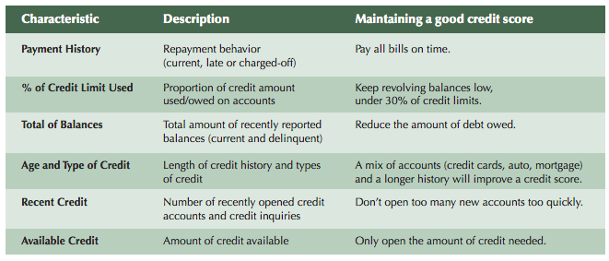

Slide 69
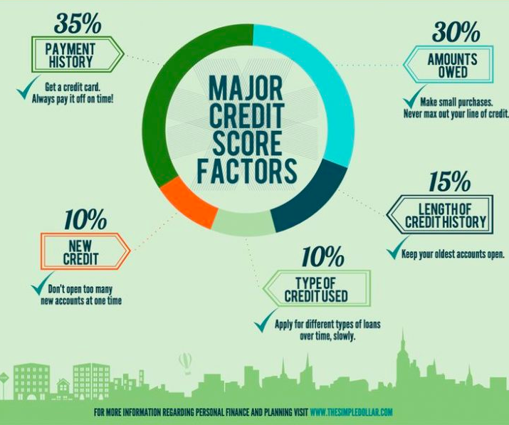
Credit Score Factors

Slide 70
What do Credit Scores mean?
Scores range from 300-850

Slide 71
Negatives
Credit utilization 30%
Missing a card or loan payment
Maxing out a credit card
Debt consolidation
Refinancing a home, student or car loan
Canceling a credit card
Being an authorized user on someone’s bad account
Credit report errors
Length of credit history 15%
Applying for too many credit cards
Refinancing a home, student or car loan
Canceling a credit card
Not having a credit card
Credit report errors
Payment history 35%
Missing a card or loan payment
Collections and charge-offs
Bankruptcy
Foreclosure
Deed in lieu
Short sale
Tax lien
Debt settlement
Refinancing a home, student or car loan
Being an authorized user on someone’s “bad” account
Not having a credit card
Credit report errors
New credit 10%
Hard inquiries
Applying for too many credit cards
Debt consolidation
Refinancing a home, student or car loan
Errors in your credit report
Credit mix 10%
Applying for too many credit cards

Slide 72
Positive Credit Score habits
Get your free credit report
Review your report thoroughly- if there are mistakes, fix them
Start paying bills on time- set yourself a reminder or use automatic draft.
Focus on your credit card bills
Avoid opening new accounts
Keep late payments under 30 days
Establish a credit score objective
Avoid high credit card balances
Set up automatic payments
Keep your longest account open
Create & sustain an emergency fund
Stay away from pricey credit monitoring providers- You can usually get free credit score through your bank or credit card.

Slide 74
Balanced scorecard slide 10
THANK YOU

