Slide 1
Competition and Market Structures
Chapter 7
Created by Natalie Harmon

Slide 2
Is competition important for our economy?

Slide 3
Happy Valentine’s Day
Please be sure to pick up the study guide on the way in for Chapter 7.
Help yourself to a Valentine’s Day pencil & sticker
Warm up #10 (I think?)
Is competition important for our economy?
Who benefits from competition? How?

Slide 4
Activity

Slide 5
Market Structures
Key Concept:
An economic model that helps economists examine the nature and degree of competition among businesses in the same industry.
Why does it mater?
The level of competition impacts the prices of products.
The more sellers compete for your dollars, the more competitive the prices will be.

Slide 6
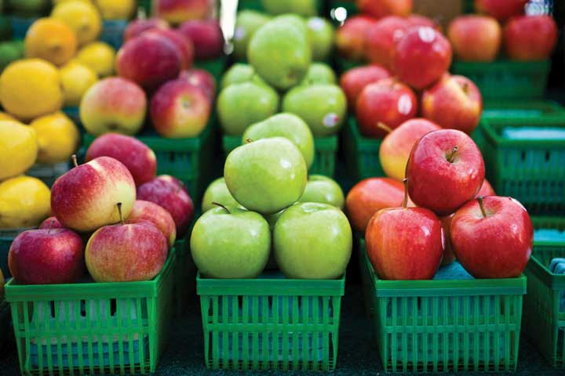
Perfect Competition
1
Key Features:
Large number of firms producing same products
Price is set by the buyer
Each firm’s production level does not influence the price
Few barriers to entry
Examples:
Agriculture

Slide 7
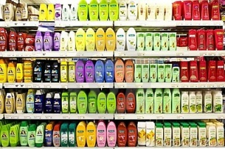
Monopolistic Competition
2
Key Features:
Large number of firms
Similar but differentiated products
Slight control over price
Few barriers to entry
Examples:
Jeans
Shampoo
Shoes

Slide 8
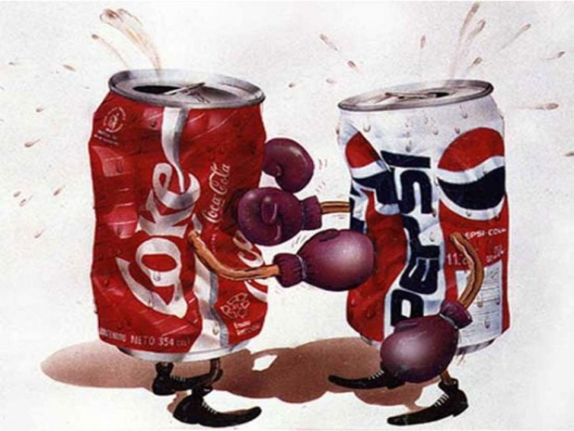
Oligopoly
3
https://www.youtube.com/watch?v=N0L00FZnhtg
Key Features:
Market dominated by a few large profitable firms (3-4 control 70-80%)
Little or no true price competition
Firms are interdependent
Significant barriers to entry (startup costs are high)
Examples:
Breakfast Cereal
Soft Drinks
Laundry Detergent

Slide 9
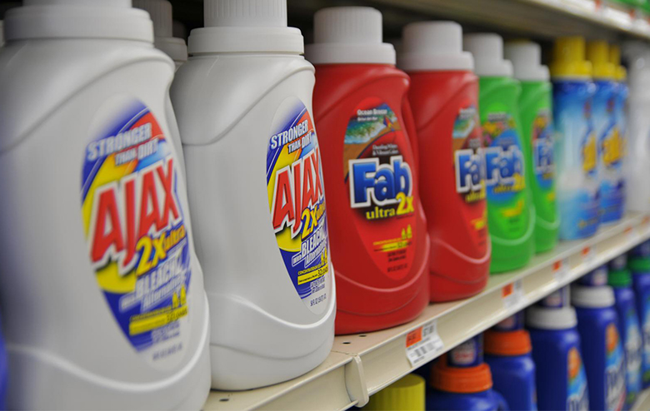
Oligopoly cont…
3
Collusion:
An agreement among firms (cartel) to set prices
Predatory Pricing:
Selling a product below cost to drive competitors out of the market
ILLEGAL
Notes:
In France, between 1997 and 2004, the top four laundry detergent producers (Proctor & Gamble, Henkel, Unilever, and Colgate-Palmolive) controlled about 90 percent of the French soap market. Officials from the soap firms were meeting secretly, in out-of-the-way, small cafés around Paris. Their goals: Stamp out competition and set prices.

Slide 10
Monopoly
4
Colbert Report: The Word- Monopoly (starts at 1:20)
http://www.cc.com/video-clips/to3c41/the-colbert-report-the-word---monopoly

Slide 11
Monopoly
4
Key Features:
One seller dominates the market
Controls supply and prices because there are no close substitutes
High barriers to entry
In most countries monopolies are illegal
Examples:
Microsoft
Utilities
Potential monopoly: AT&T and Time Warner merger

Slide 12
Market Structures
Perfect Competition
Monopolistic Competition
Oligopoly
Monopoly
More Competition
Less Competition
Less Concentration
More Concentration
Notes:
When competition is absent, the market is said to be concentrated.

Slide 13
Let’s play a game!

Slide 14
Is competition important for our economy?

Slide 15
One last thing!

Slide 16
Exit Ticket
Create a multiple choice question based on something you learned about market structures.
You need to include 4 answers to choose from.
Put a star next to the right answer.
Don’t forget to put your name & period on your paper.

